Slide 1
Mechanics of an ICS/SCADA Man-In-The-Middle Attack

Slide 2
Jim Gilsinn
Senior Investigator, Kenexis Consulting
ICS Network & Security Assessments & Designs
Developer, Dulcet Analytics, Reliability Monitoring Tool
Previous Life – NIST Engineering Lab
20+ Years Engineering
ICS Cyber Security & Network Performance
Control Systems, Automated Vehicles, Wireless Sensors & Systems
International Society of Automation (ISA)
ISA99 Committee, Co-Chair (ISA/IEC 62443 Standard Series)
ISA99-WG2, Co-Chair (ICS Security Program)

Slide 3
MITM Attacks Are Nothing New
Man-in-the-middle attacks have been around for a long time
They utilize loopholes in some of the basic network protocols
Allows an attacker to impersonate another device
There are TONS of videos and tutorials on the Internet on how to conduct a MITM attack
This IS NOT a talk about how to run a MITM attack

Slide 4
What is this Talk About, Then?
This IS a talk about what happens to the systems when you run a MITM attack
ICS/SCADA rely on deterministic communications
How does a MITM attack affect those deterministic communications?
Can you detect a MITM attack using simple tools?
Or, do you really need a full IDS system to detect it?

Slide 5
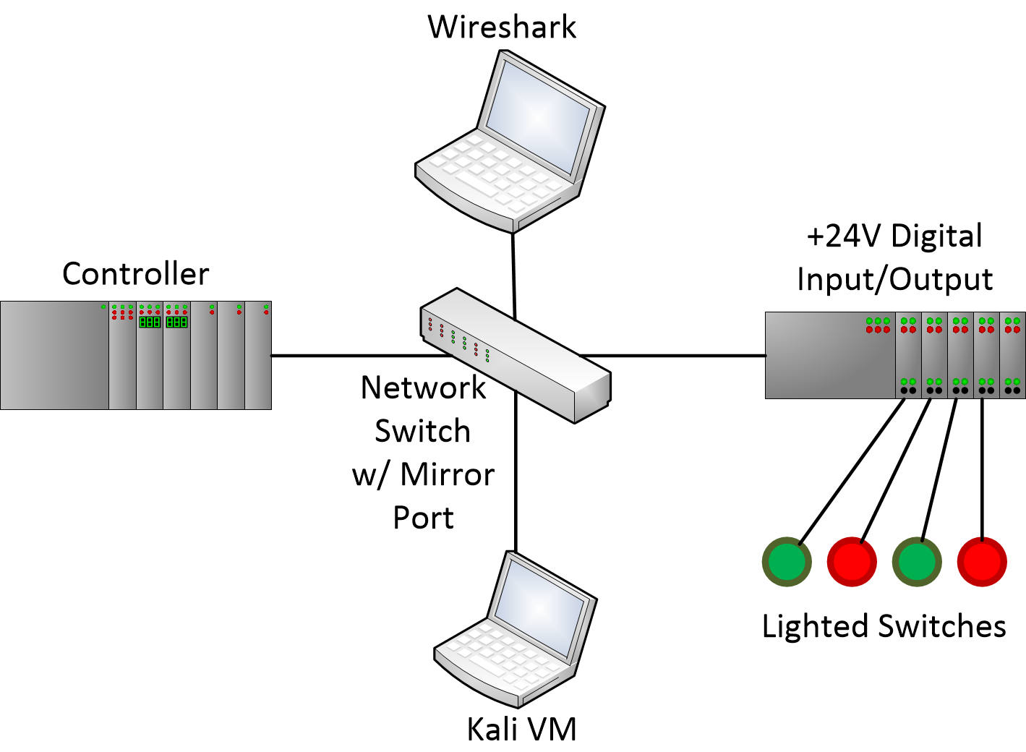
Man-In-The-Middle Testing
Kali Linux VM
Ettercap
ARP Poisoning
All default settings (script-kiddy style)
Captured traffic off mirror port
Separate Kali Linux native machine with Wireshark
PLC to I/O
EtherNet/IP™
10ms frequency
MITM against PLC

Slide 6
A Little Bit About EtherNet/IP™
Originally developed by Rockwell Automation
Now managed by ODVA, Inc.
Generally used at lower-levels in ICS/SCADA architecture
Controllers (PLCs), HMI, I/O, motors, sensors, etc.
Level 4-7+ layer protocol
Uses standard, unmodified TCP/UDP/IP stack
Has both command/response and publish/subscribe type communications
Command/response
TCP – 44818
Unconnected messaging
No long-duration TCP connection
Usually for initializing other connections
Connected messaging
Long-duration TCP connection maintained
Periodic data transfers
Publish/subscribe
UDP – 2222
Real-time messaging
Unicast from subscriber, multicast or unicast from publisher
Allows multiple subscribers

Slide 7
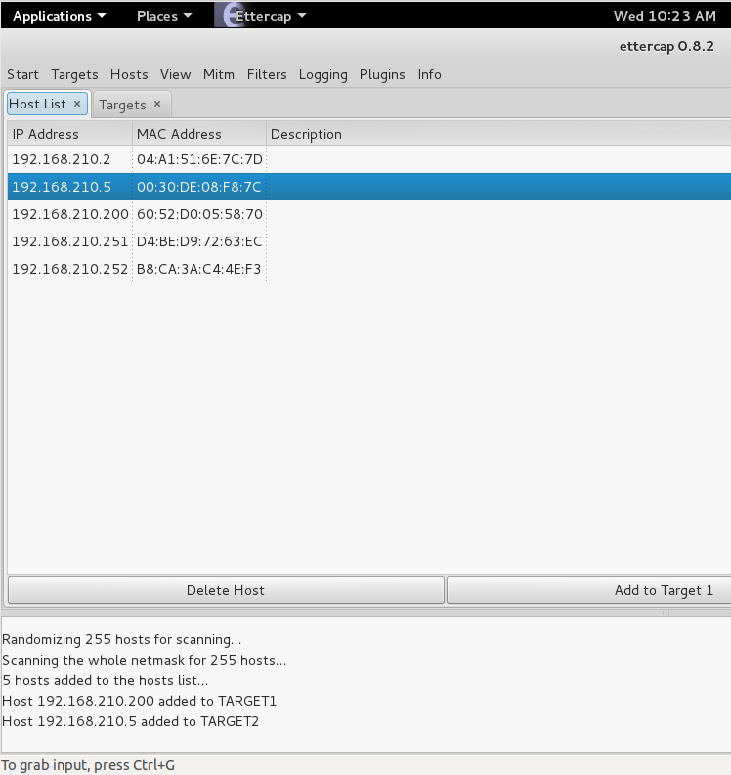
Description of MITM Attack – Hosts List
PLC
I/O Block
Netgear GS108E
MITM Machine
Kali Linux 2.0 VM
Ettercap 0.8.2 (default Kali version)
Capture Machine
Kali Linux 2.0 Native
Wireshark 1.12.?

Slide 8
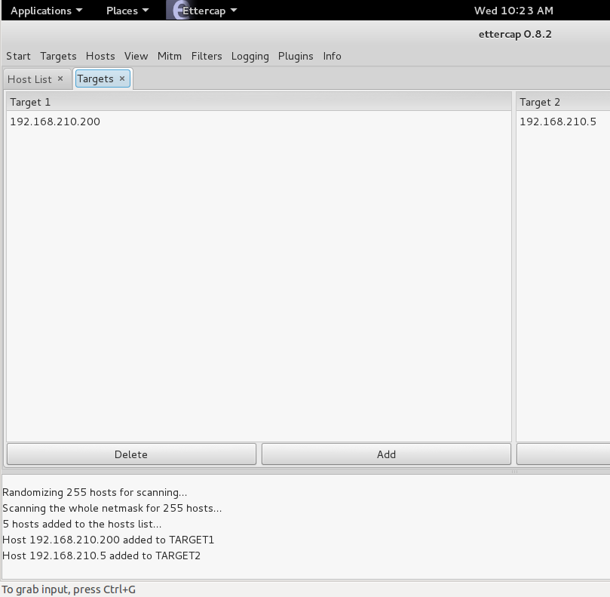
Description of MITM Attack – Targets
Target 1
Main target of MITM attack
PLC
Target 2
Other target of MITM attack
I/O Block

Slide 9
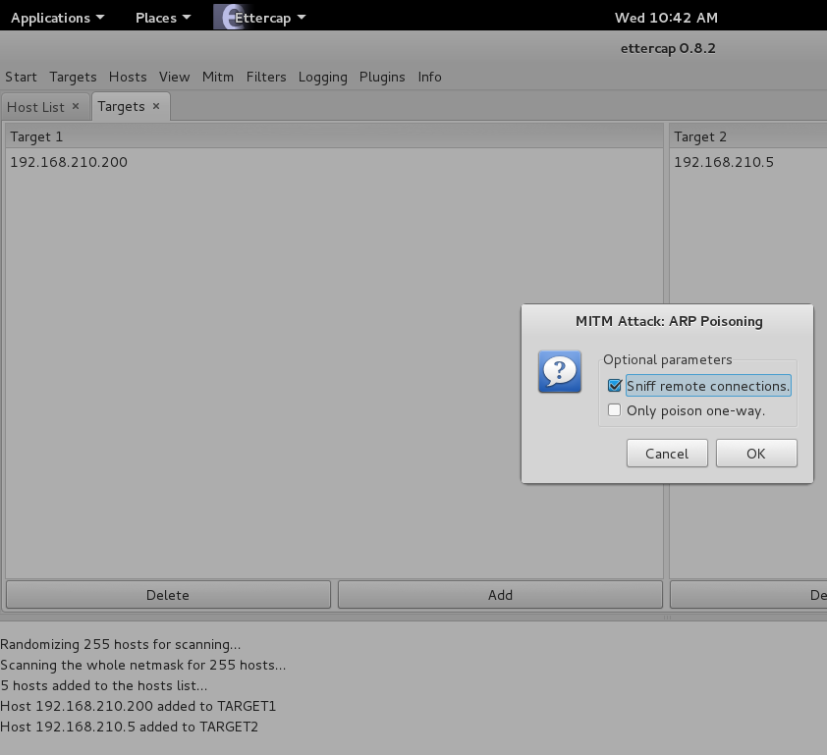
Description of MITM Attack – ARP Poison
ARP Poison using “Sniff remote connections” option
Since network extremely small, other attacks didn’t work
ARP Poisoning seemed to get through relatively undetected
VirusTotal
NetworkMiner
Bro

Slide 10
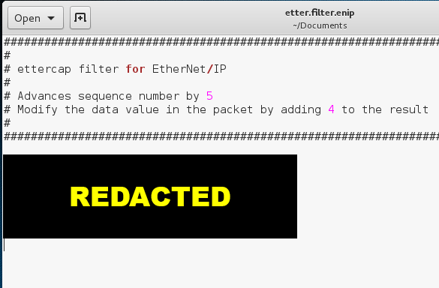
Description of MITM Attack – Filtering
Filtered MITM Attack to modify EtherNet/IP-specific packet fields
Advanced sequence number by 5
Modified data value by adding 4 (decimal)

Slide 11
Description of MITM Attack – Tests Conducted
Multicast I/O Block Publisher
Baseline
Baseline w/ button pushes
MITM attack
MITM attack w/ button pushes
MITM attack w/ filter
MITM attack w/ filter & button pushes
Unicast I/O Block Publisher
Baseline
Baseline w/ button pushes
MITM attack
MITM attack w/ button pushes
MITM attack w/ filter
MITM attack w/ filter & button pushes

Slide 12
Connection Details
PLC
MAC Address = 60:52:d0:05:58:70
IP Address = 192.168.210.200
I/O Block
MAC Address = 00:30:de:08:f8:7c
IP Address = 192.168.210.5
PLC -> I/O Block
10ms cyclic frequency
Unicast
I/O Block -> PLC
10ms cyclic frequency
Multicast connection uses 239.192.1.128
VMWare
MAC Address = 00:0c:29:87:b6:45

Slide 13
Baseline

Slide 14
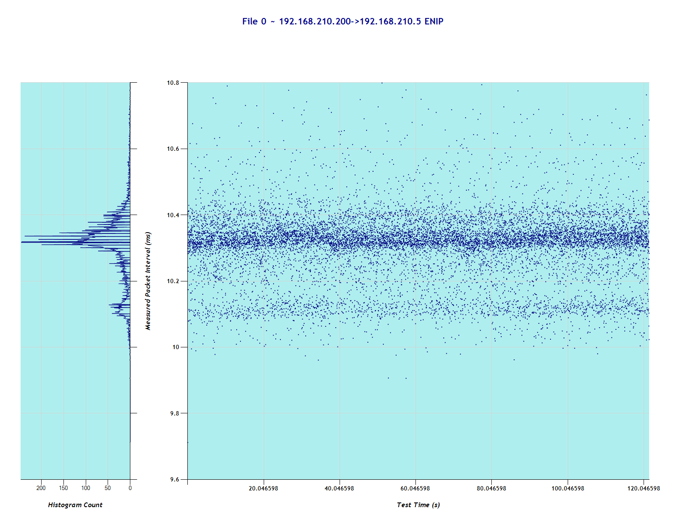
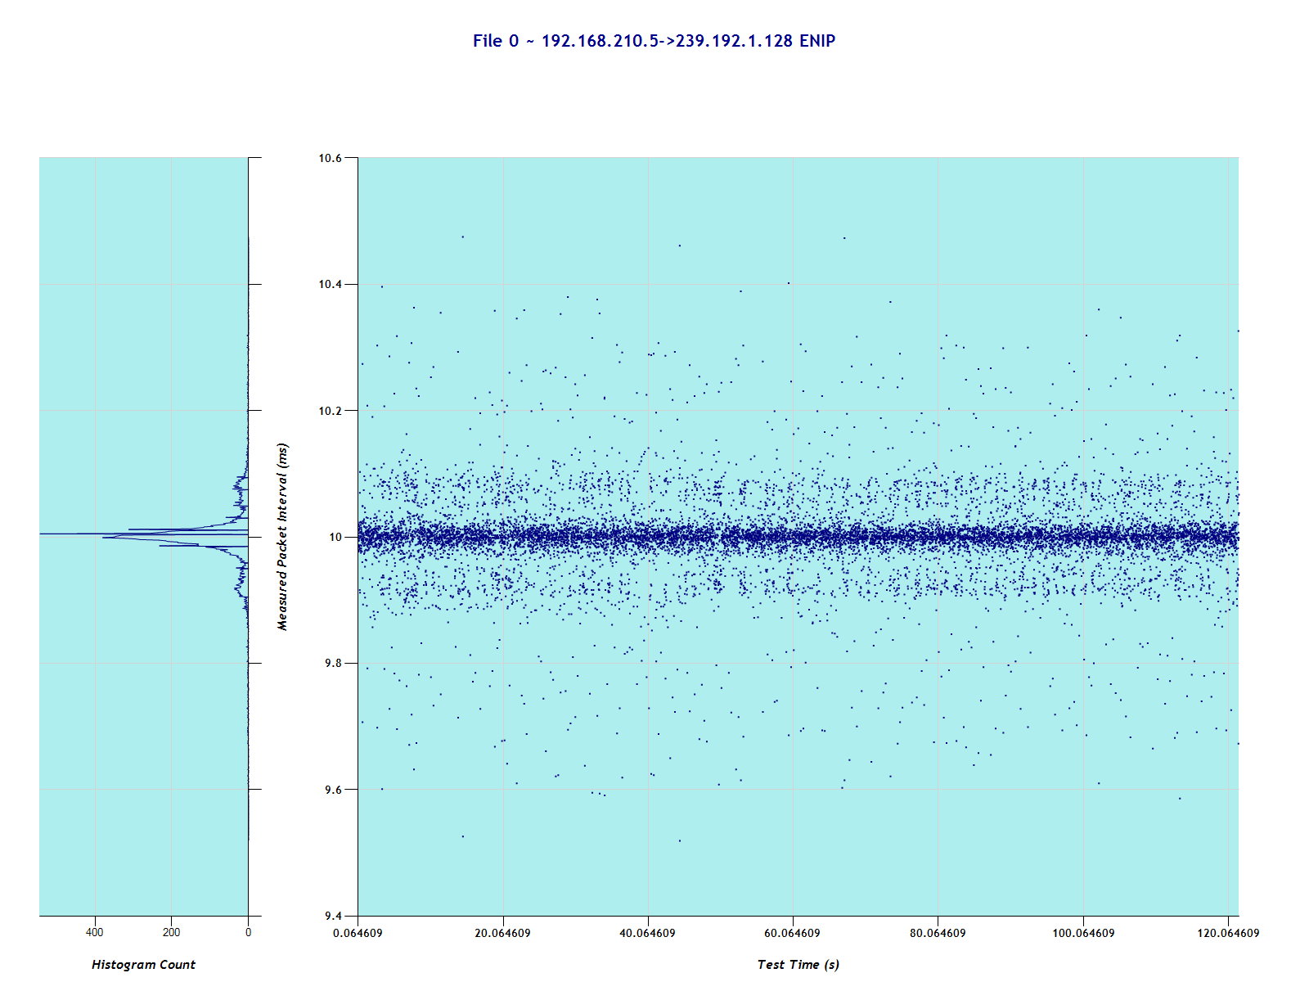
Baseline
PLC -> I/O Block
~10ms cyclic frequency
~500µs distribution
I/O Block -> PLC
~10ms cyclic frequency
~400µs distribution

Slide 15
MITM Attack – Multicast

Slide 16
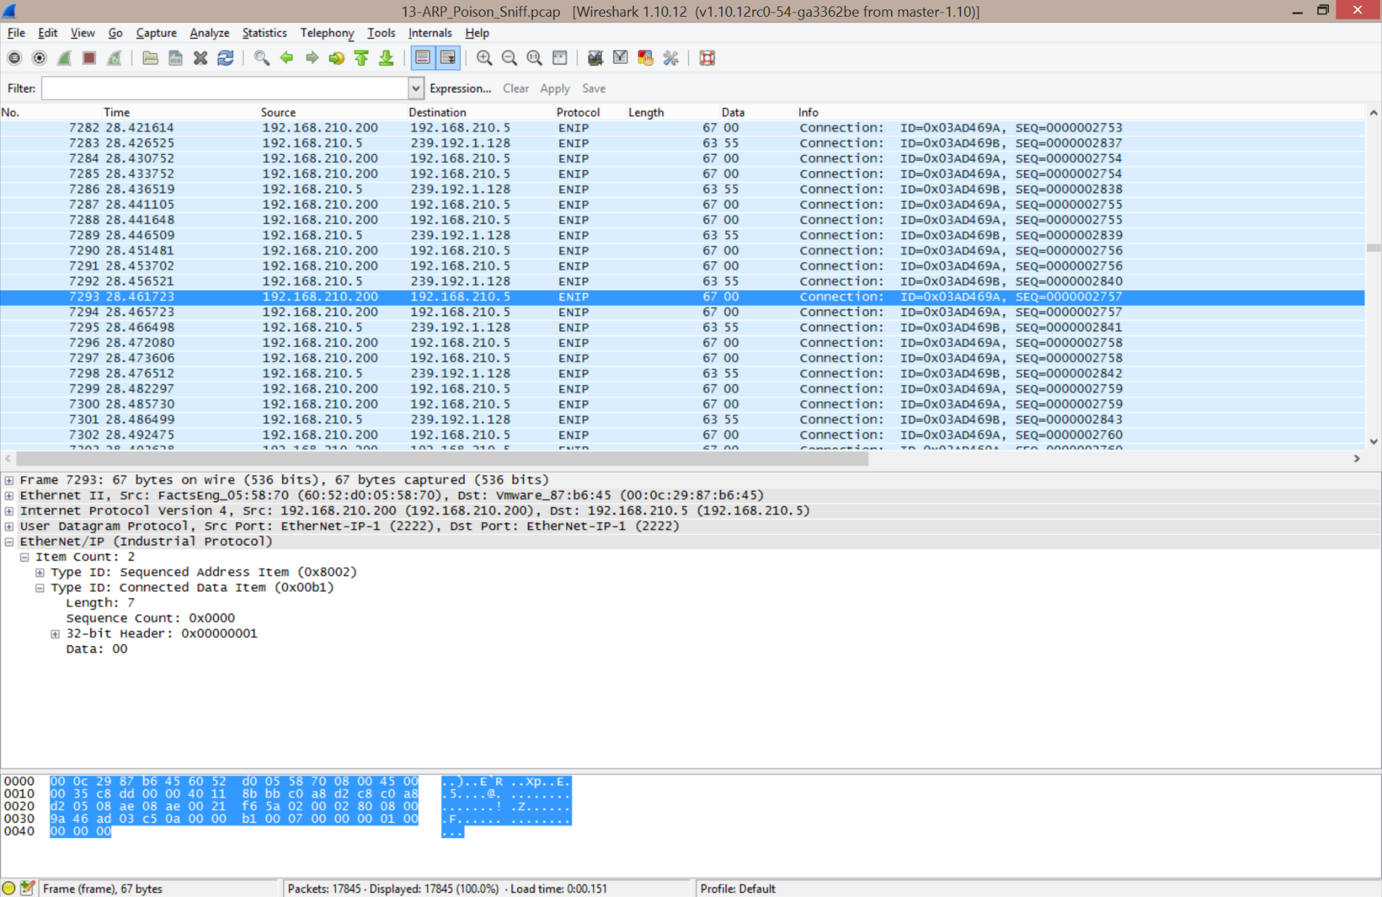
MITM – Multicast

Slide 17
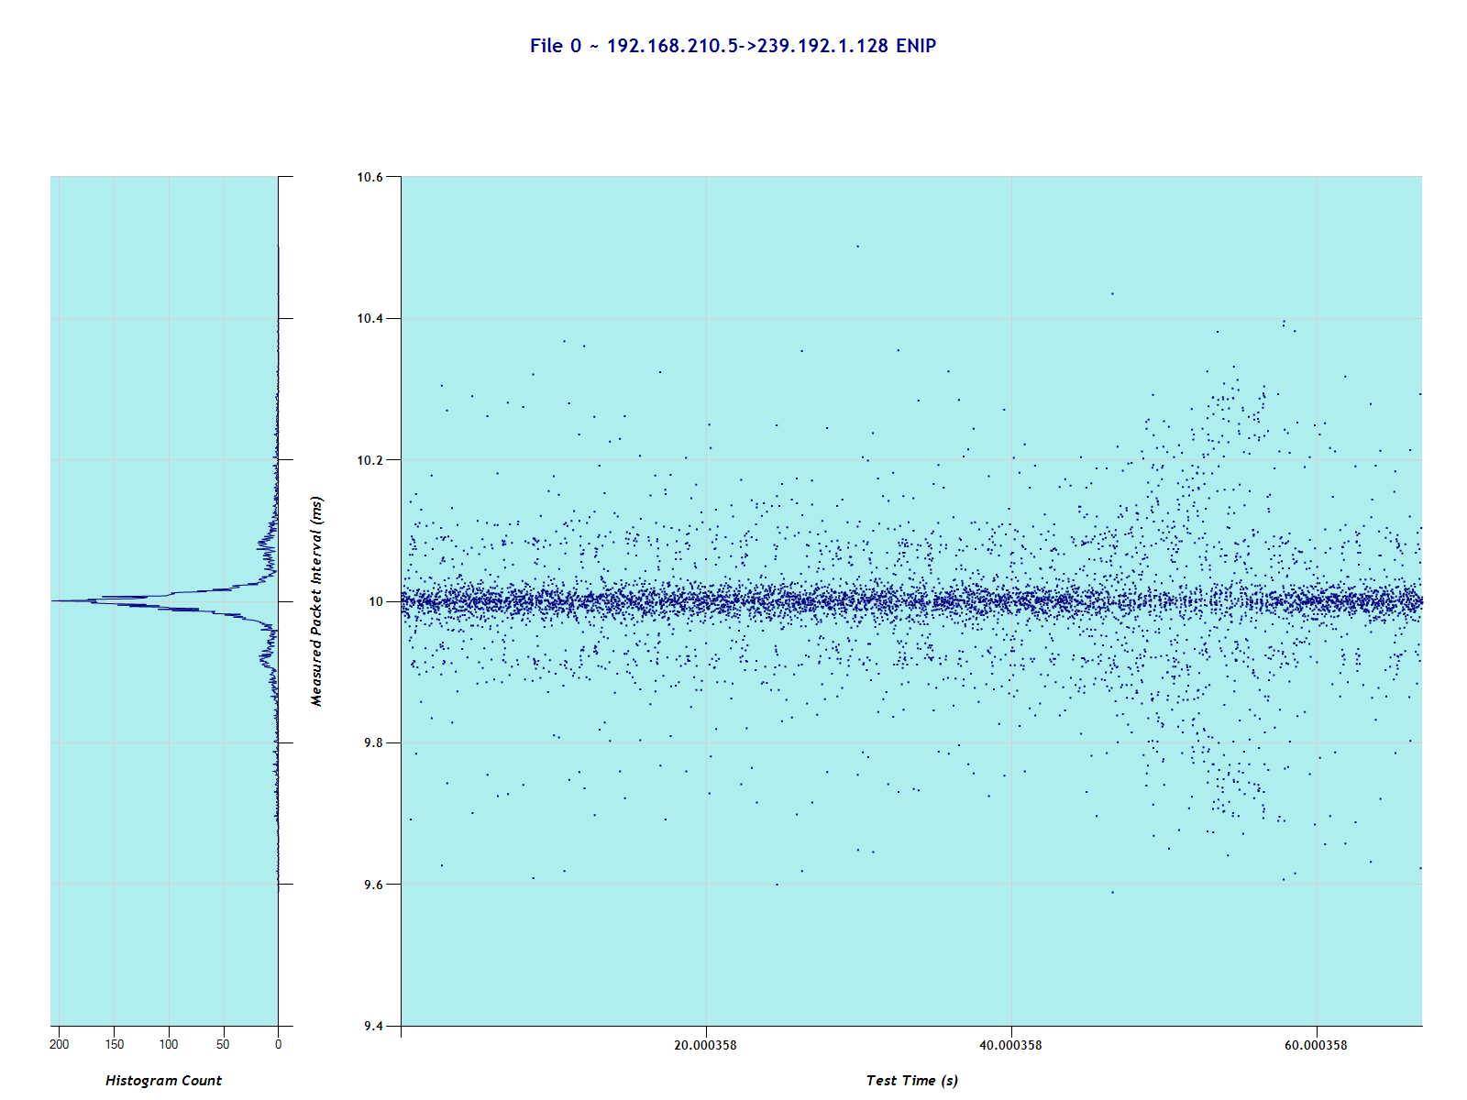
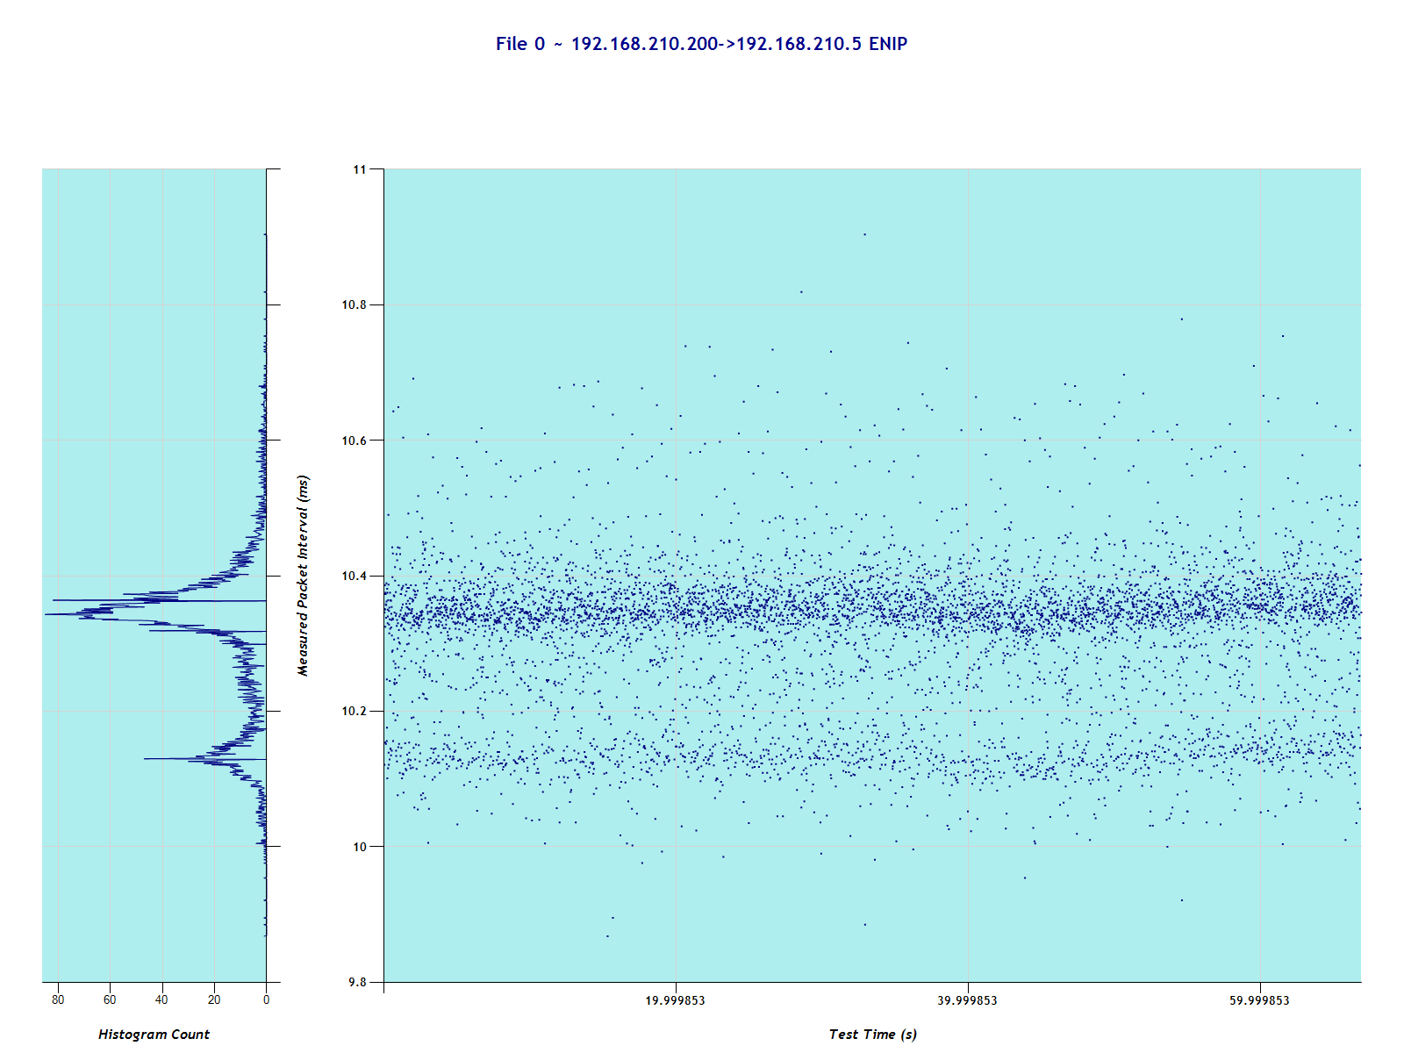
MITM – Multicast
I/O Block -> PLC
~10ms cyclic frequency
~400µs distribution
No Difference
PLC -> MITM
~10ms cyclic frequency
~400µs distribution
No Difference

Slide 18
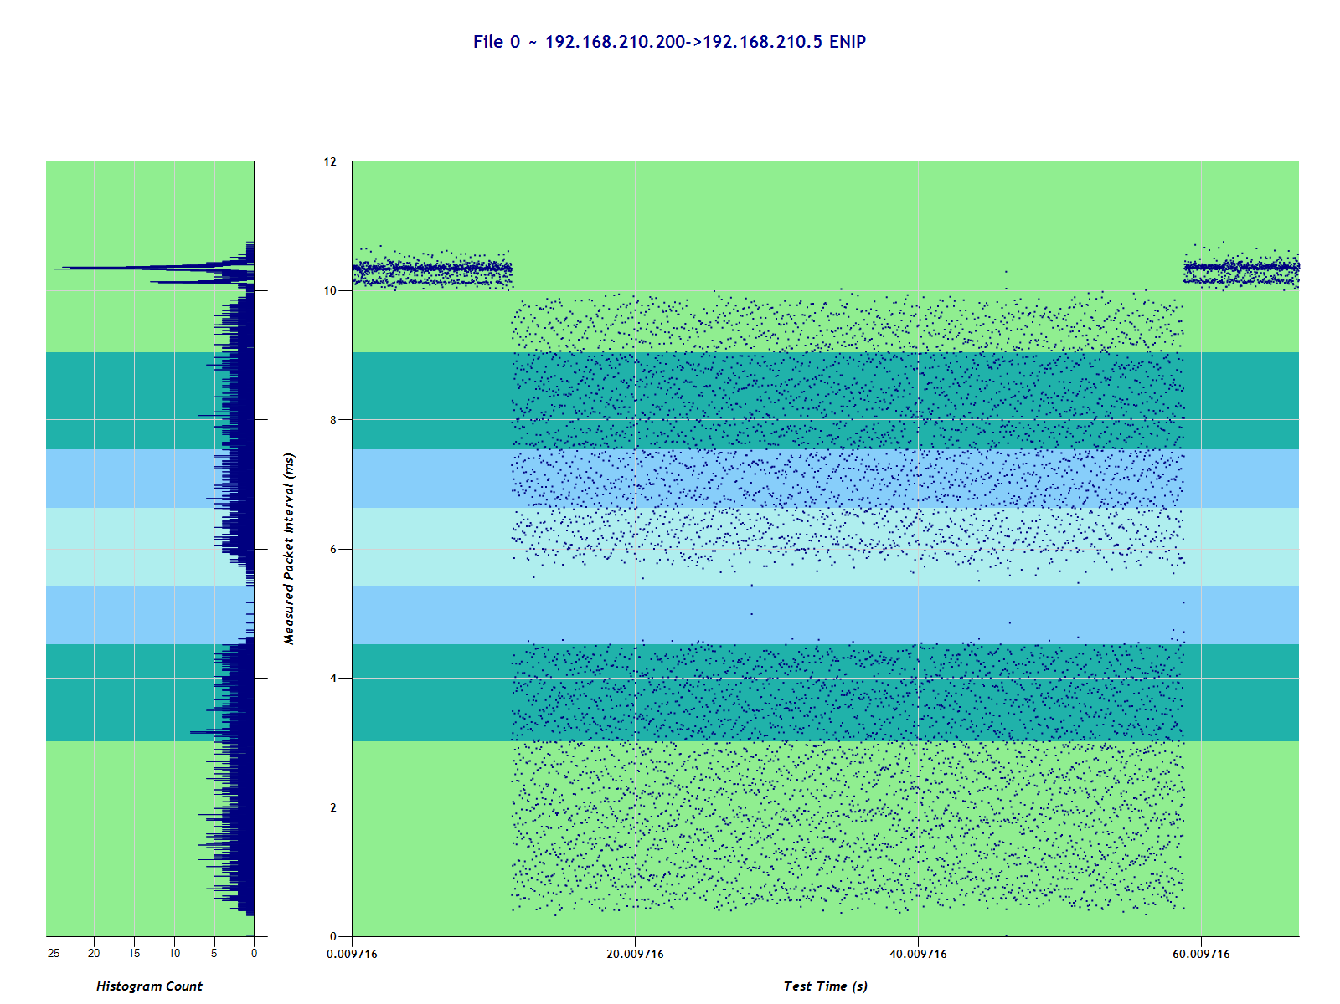
MITM – Multicast – IP-based analysis
192.168.210.200 -> 192.168.210.5
MITM instantly recognizable
Distribution extremely wide
Mean shifts down along distribution

Slide 19
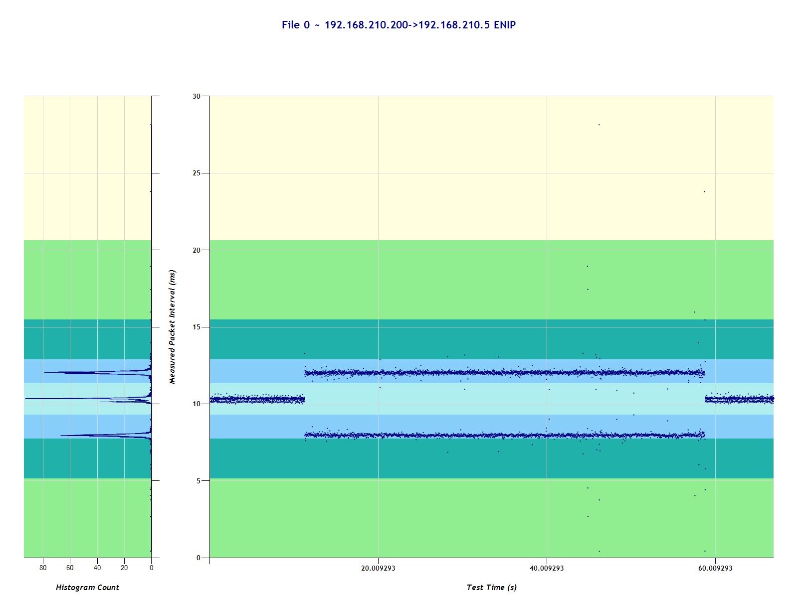
MITM – Multicast – MAC-based analysis – I/O Block Dst
Using the MAC address of the I/O block, isolate the traffic stream
MITM recognizable
Distribution recognizable
Mean remains the same

Slide 20
MITM Attack – Unicast

Slide 21
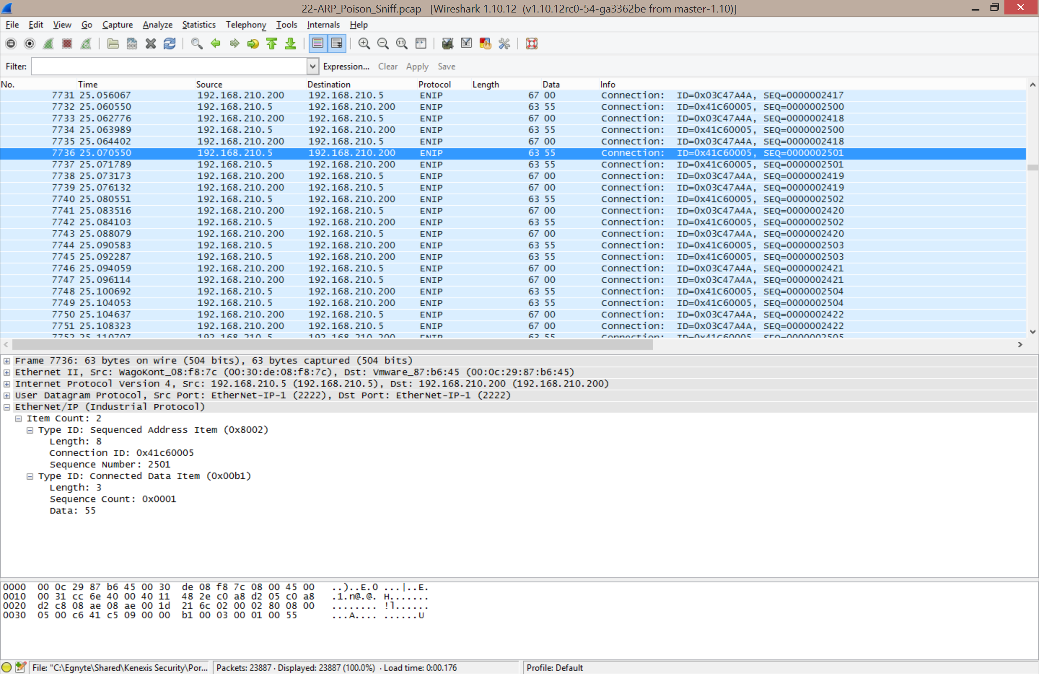
MITM – Unicast

Slide 22
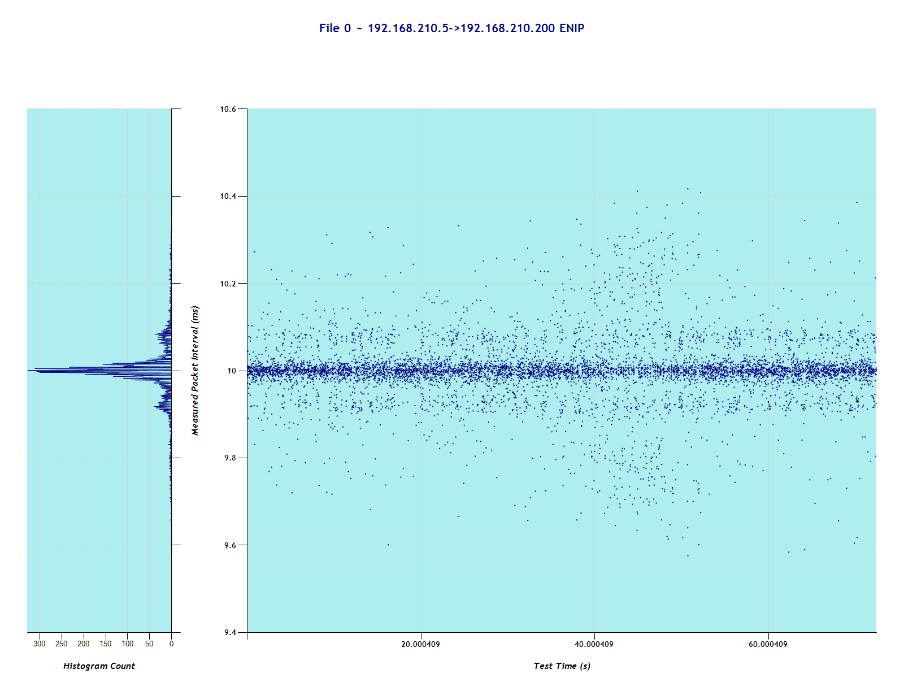
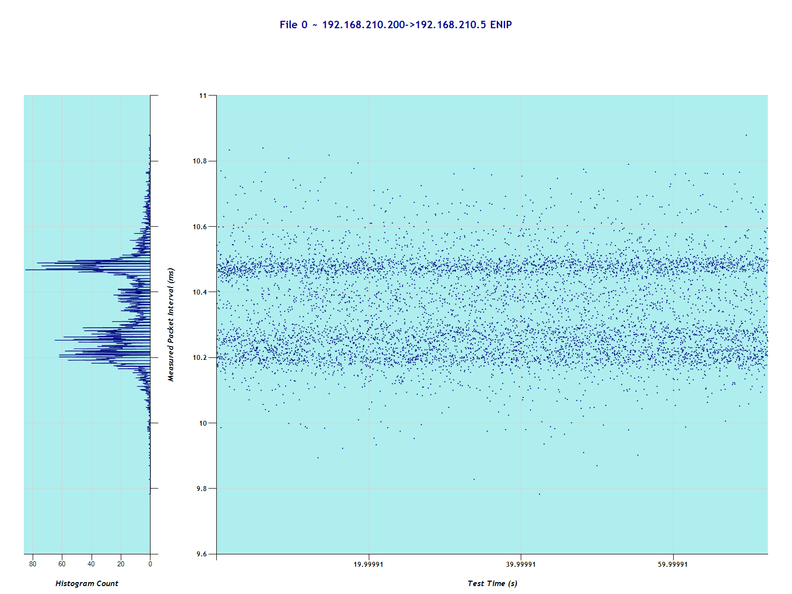
MITM – Unicast
I/O Block -> PLC
~10ms cyclic frequency
~400µs distribution
No Difference
PLC -> MITM
~10ms cyclic frequency
~400µs distribution
No Difference

Slide 23
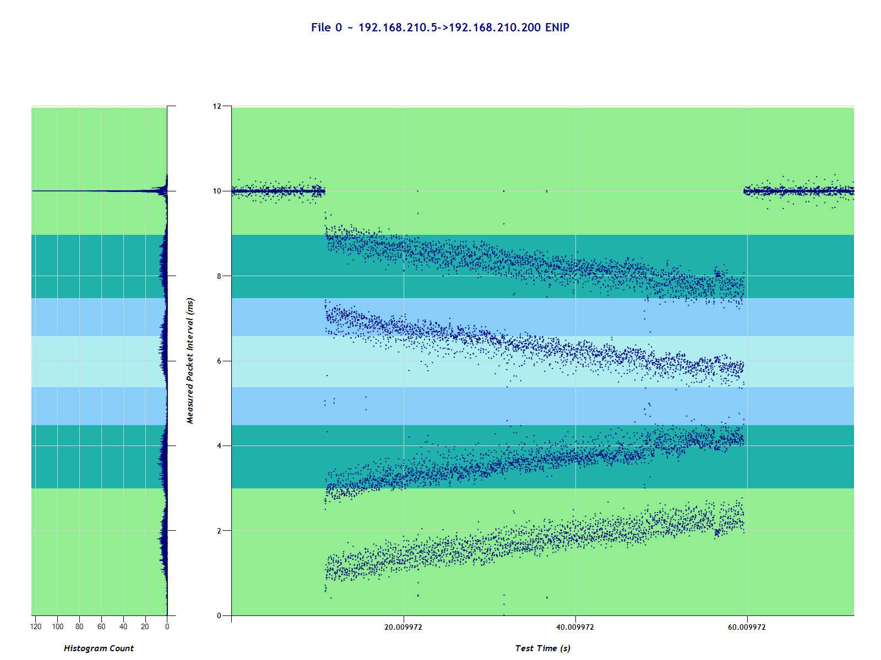
MITM – Unicast – IP-based analysis
192.168.210.5 -> 192.168.210.200
MITM instantly recognizable
Distribution extremely wide
Mean shifts down along distribution
Herringbone pattern probably due to clock skew

Slide 24
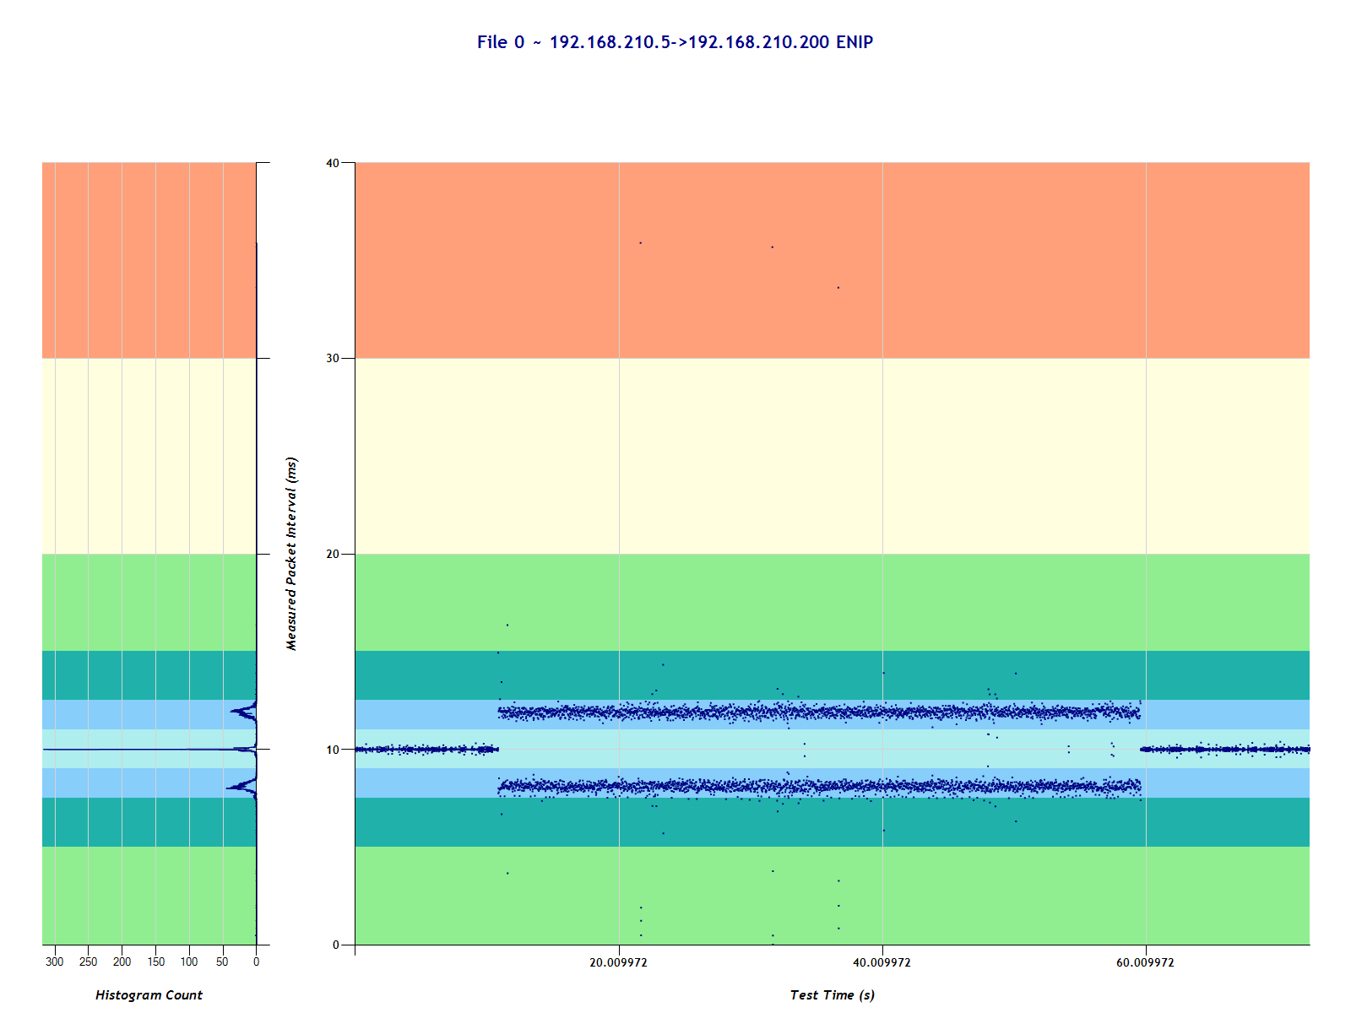
MITM – Unicast – MAC-based analysis – PLC Dst
Using the MAC address of the PLC, isolate the traffic stream
MITM recognizable
Distribution recognizable
Mean remains the same

Slide 25
MITM – Filter
Additional testing was conducted to see if filters caused any performance differences
The intent wasn’t to do an awesome Stuxnet-type attack
Adjusted sequence number to spoof out the signals
Modify the I/O data in the packets to change light action related to button pushes

Slide 26
MITM – Filter – Base Button Pushes
Buttons | PLC->I/O Unfiltered | I/O->PLC Unfiltered | PLC->I/O Filtered | I/O->PLC Filtered
0 0 0 0 | 0x00 | 0x55 | 0x04 | 0x55
1 0 0 0 | 0x01 | 0x56 | 0x05 | 0x56
0 1 0 0 | 0x04 | 0x59 | 0x08 | 0x59
0 0 1 0 | 0x10 | 0x61 | 0x14 | 0x61
0 0 0 1 | 0x40 | 0x95 | 0x44 | 0x95

Slide 27
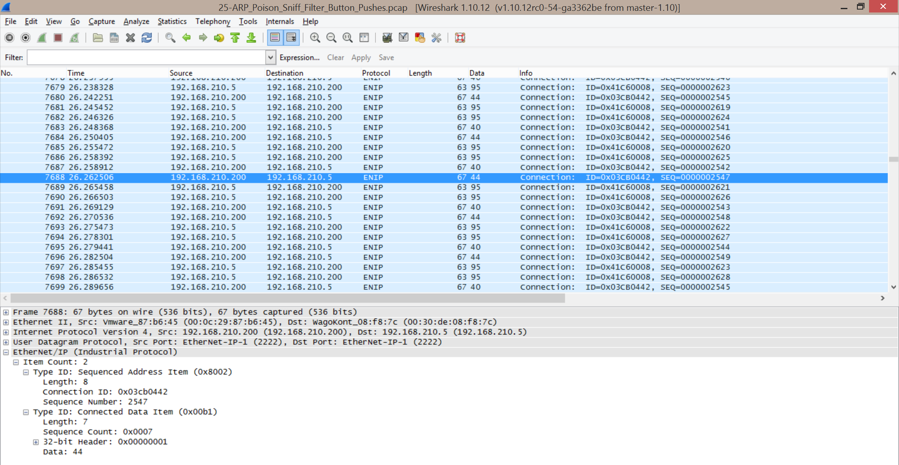
MITM – Filter

Slide 28
Captures
I hope to post the capture files shortly
Check my Twitter feed for more info
I need to get approval first
EDIT:
Capture files available at

Slide 29

Questions & Comments?
Jim Gilsinn
Senior Investigator, Kenexis
+1-614-323-2254
Jim.Gilsinn@Kenexis.com
@JimGilsinn

